Slide 1














SARCathon-2024
Hackathon
Omkar Shirpure
Suryansh Patidar

Slide 2

Requirements
To Build an FAQ model that provides :
Intelligent Accurate Matching to query
is Fast
is Scalable
Clean and intuitive UI for users.

Slide 3

Let’s have a Demo First...!!!

Slide 4
Semantic Understanding
01.
We leveraged Sentence-BERT (SBERT) to convert both user queries and FAQ questions into meaningful sentence embeddings, capturing the semantic relationships between sentences
How did we implement an Intelligent Closest
Match engine?
Efficient Matching:
02.
Our solution employs cosine similarity to compute how closely the query matches each FAQ question, ensuring the top matches are selected based on their semantic similarity scores
Adaptive Learning
03.
We continuously update the FAQ database by dynamically adding new questions and recomputing embeddings, enhancing the system's ability to find relevant answers over time

Slide 5
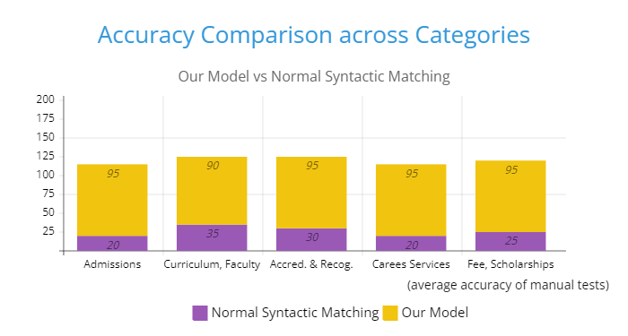
But how accurate is it?
Pretty accurate...
Test it yourself..!!

Slide 6
Precomputed Embeddings
01.
All FAQ questions are pre-encoded into high-dimensional embeddings using SBERT, eliminating the need for real-time encoding during search, which significantly speeds up query processing.
Efficient Cosine Similarity Calculation
How is it Fast?
02.
Cosine similarity allows for quick, vectorized computation of similarities between the precomputed embeddings and the query embedding, ensuring rapid identification of the closest matches.
Reduced Search Space
03.
By leveraging SBERT embeddings, semantic similarities are captured, reducing the need for exhaustive keyword-based searches, enabling fast and intelligent matching even in large datasets

Slide 7
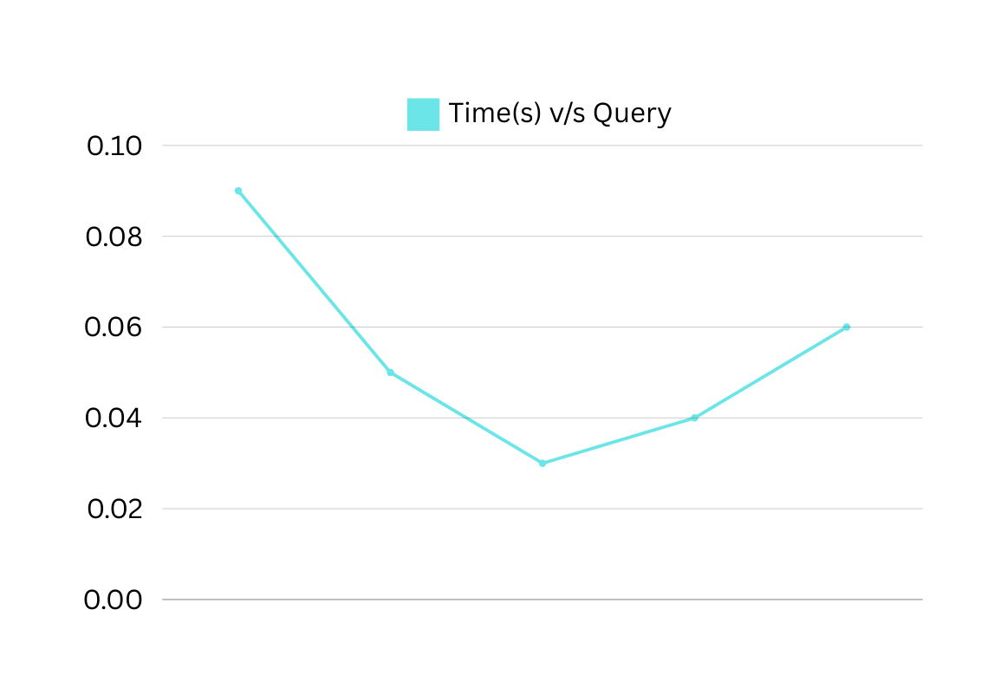
And how Fast is it?
Faster than you blink actually....!!
Notice the time for results in Demo?!

Slide 8
Vectorized Operations
01.
Since we use precomputed embeddings and vectorized operations like cosine similarity, it allows the system to handle large datasets efficiently, scaling linearly as more questions are added.
Wait... Is our Solution Scalable?
Batch Processing and Parallelism
02.
SBERT supports batch processing and parallel computation, allowing for the efficient encoding of large numbers of new questions, making it easier to scale as the FAQ database grows.
Yepp...!!
Containerizing
03.
Dockerized applications along with Kubernetes orchestration make it easy to scale the backend and frontend scalable by containerizing the modules to meet the traffic needs.

Slide 9

User Experience
Has a Clean UI
Features like ‘See Also’
Build a clean, themed UI for easy search and better user experience.
Provides more related sentences to the query, to cater the need of exploration and overall clarity

Slide 10
Tech Stack to build the FAQ app
Flutter
Django

Slide 11
Why Flutter?
Easy to implement..!!
Cross Platform Support
01.
02.
Flutter being easy, has large community support and fast to build with clean UI for production, it was our first choice for a front-end framework.
Flutter supports deployment in Android, iOS, web, web embeddings, and Linux Apps. All through a single codebase..!!
Still not a fan of Flutter?
Hey, you still have APIs right..!!

Slide 12
Python Compatibility
01.
Django is built on Python, allowing seamless integration with various ML Python libs and frameworks
Rapid Development
Why Django?
02.
Django follows the "Don't Repeat Yourself" (DRY) principle, enabling developers to create applications quickly and efficiently through reusable components
Robust Security Features
03.
Django comes with built-in security features to protect against common web vulnerabilities, including SQL injection, cross-site scripting (XSS), etc

Slide 13

Thank you!

